Slide 1
RCAF Association Member Appreciation Survey
Saturday, February 06, 2016

Slide 2
1198
Total Responses
Date Created: Wednesday, October 28, 2015
Complete Responses: 978

Slide 3
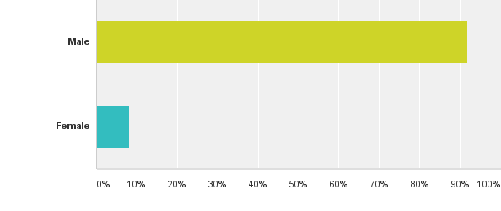
Q1: Gender
Answered: 1,176 Skipped: 22

Slide 4
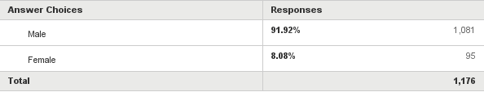
Q1: Gender
Answered: 1,176 Skipped: 22

Slide 5
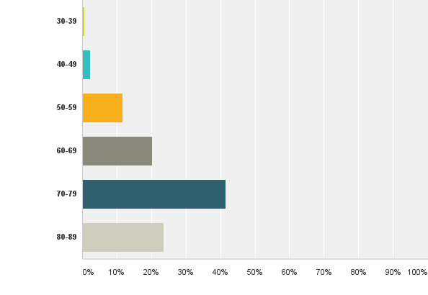
Q2: Age
Answered: 1,139 Skipped: 59

Slide 6
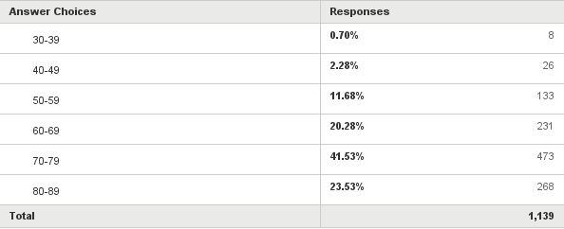
Q2: Age
Answered: 1,139 Skipped: 59

Slide 7
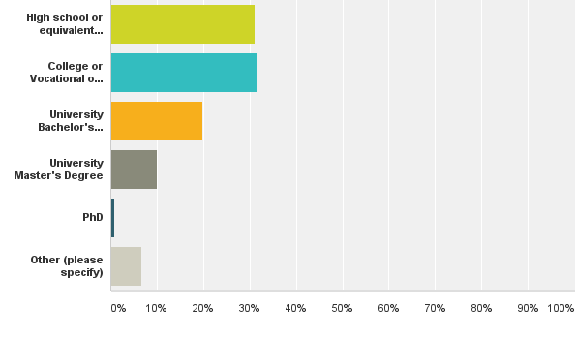
Q3: What is the highest level of school you have completed or the highest degree you have received?
Answered: 1,170 Skipped: 28

Slide 8
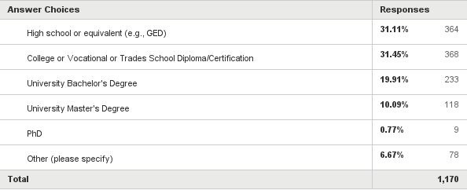
Q3: What is the highest level of school you have completed or the highest degree you have received?
Answered: 1,170 Skipped: 28

Slide 9
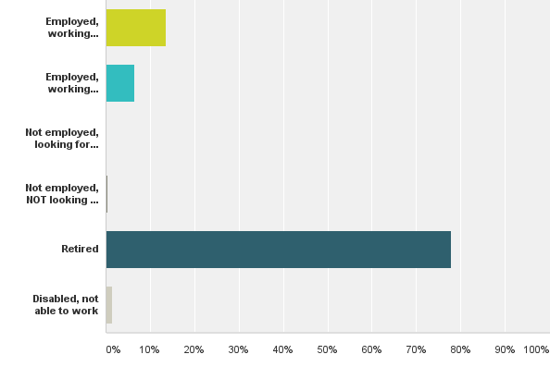
Q4: Which of the following categories best describes your employment status?
Answered: 1,180 Skipped: 18

Slide 10
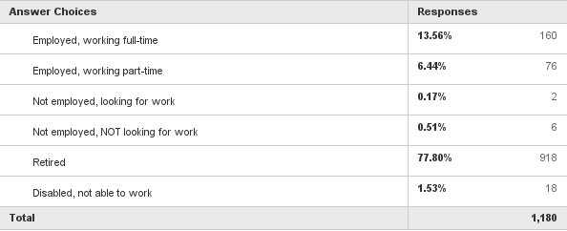
Q4: Which of the following categories best describes your employment status?
Answered: 1,180 Skipped: 18

Slide 11
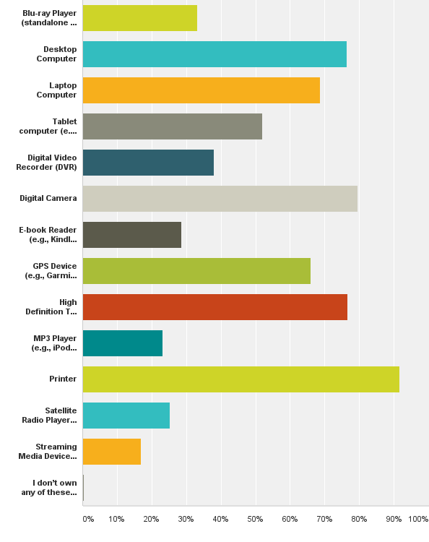
Q5: Which of the following electronic devices do you use? (Please select all that apply.)
Answered: 1,183 Skipped: 15

Slide 12
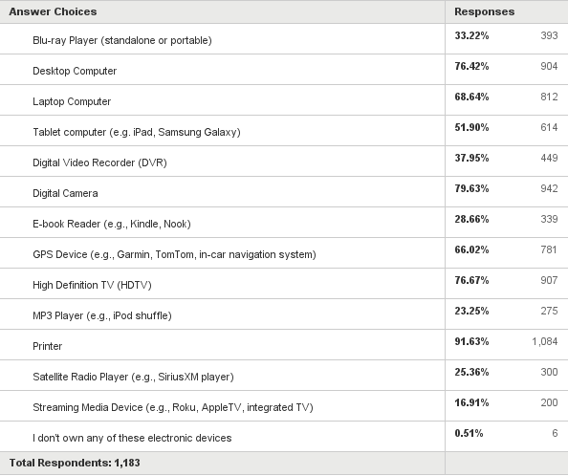
Q5: Which of the following electronic devices do you use? (Please select all that apply.)
Answered: 1,183 Skipped: 15

Slide 13
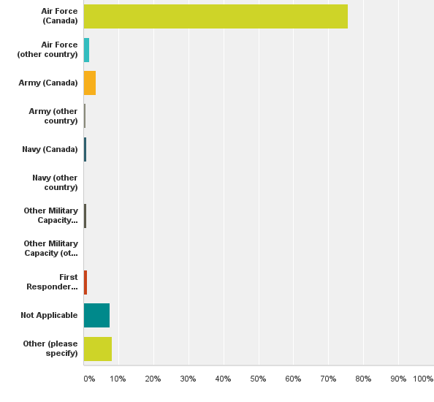
Q6: Did you ever serve in uniform (military, fire, police, other)?
Answered: 1,171 Skipped: 27

Slide 14
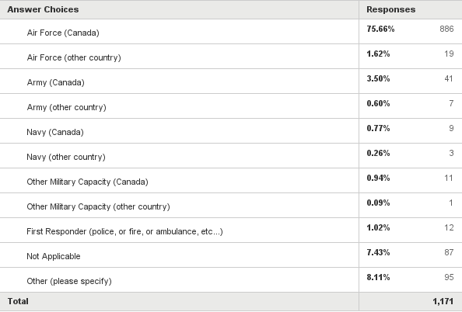
Q6: Did you ever serve in uniform (military, fire, police, other)?
Answered: 1,171 Skipped: 27

Slide 15
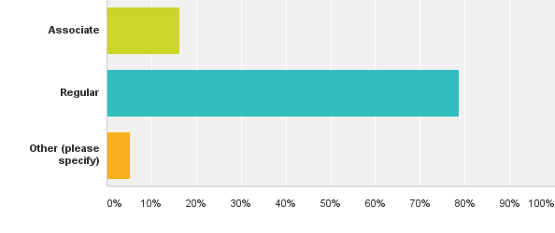
Q9: Did you first join the RCAF Association as an Associate member or Regular member? (The Associate member category was created in 1970)
Answered: 1,150 Skipped: 48

Slide 16
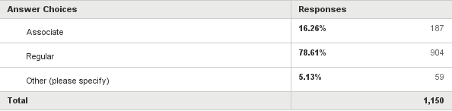
Q9: Did you first join the RCAF Association as an Associate member or Regular member? (The Associate member category was created in 1970)
Answered: 1,150 Skipped: 48

Slide 17
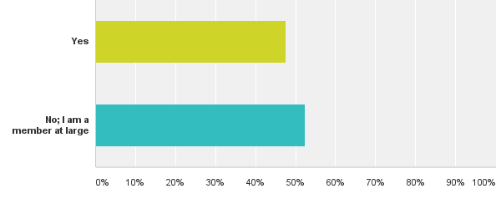
Q10: Are you currently a Wing Member?
Answered: 1,153 Skipped: 45

Slide 18
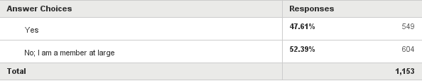
Q10: Are you currently a Wing Member?
Answered: 1,153 Skipped: 45

Slide 19
Wing Response Tally

Slide 20
Wing with highest percentage of respondents

Slide 21
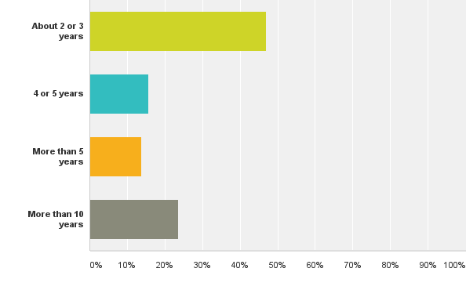
Q12: If you first joined the RCAF Association as an Associate Member, how many years passed before you achieved Regular Member status?
Answered: 51 Skipped: 1,147

Slide 22
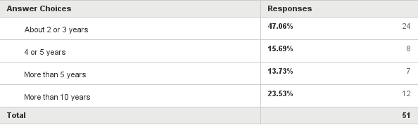
Q12: If you first joined the RCAF Association as an Associate Member, how many years passed before you achieved Regular Member status?
Answered: 51 Skipped: 1,147

Slide 23
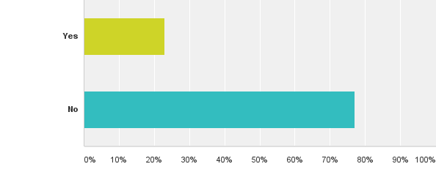
Q13: Were you ever elected to, or did you ever volunteer to stand as, Wing President?
Answered: 529 Skipped: 669

Slide 24
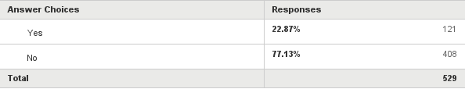
Q13: Were you ever elected to, or did you ever volunteer to stand as, Wing President?
Answered: 529 Skipped: 669

Slide 25
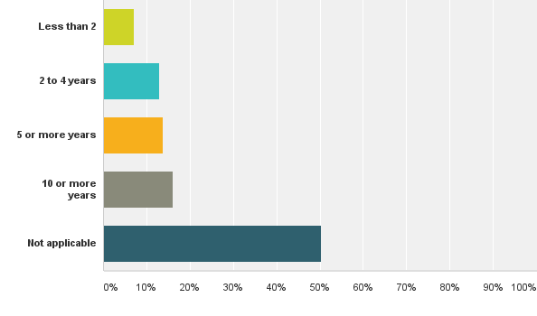
Q15: How many years have you served on the Wing Executive Council?
Answered: 481 Skipped: 717

Slide 26
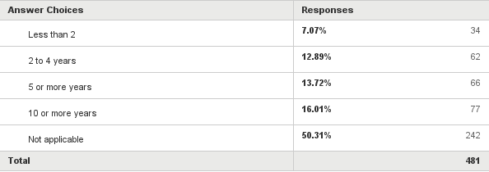
Q15: How many years have you served on the Wing Executive Council?
Answered: 481 Skipped: 717

Slide 27
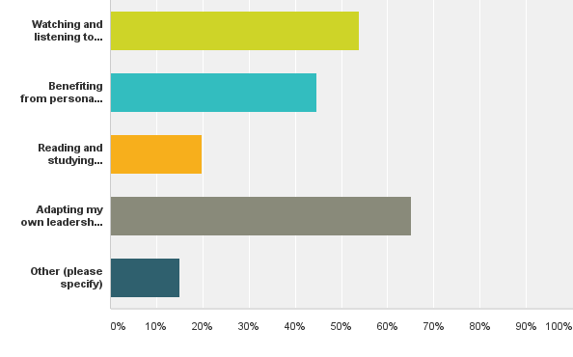
Q16: Choose from the choices below all those which may apply, in response to the following statement: I learned how to be a leader on the Wing Executive Council by:
Answered: 304 Skipped: 894

Slide 28
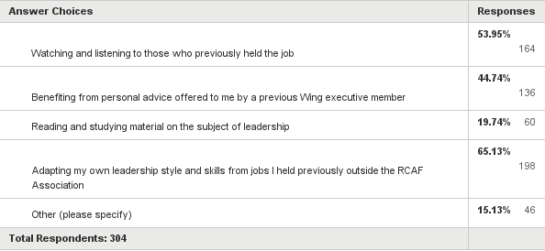
Q16: Choose from the choices below all those which may apply, in response to the following statement: I learned how to be a leader on the Wing Executive Council by:
Answered: 304 Skipped: 894

Slide 29
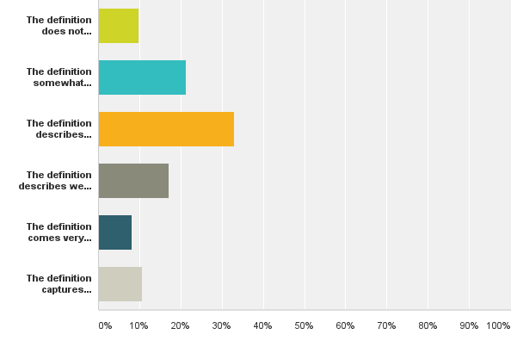
Q17: Choose from the options, below, how you feel about the following definition of the word membership: in exchange for their annual dues members benefit from a unique package of products and services they themselves help design, as a consequence of their desire to help shape the future affairs of their association
Answered: 511 Skipped: 687

Slide 30
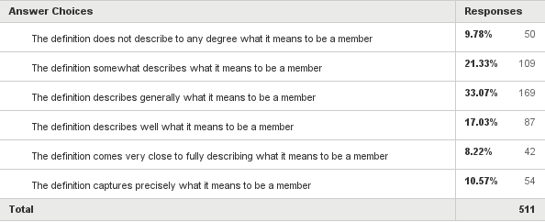
Q17: Choose from the options, below, how you feel about the following definition of the word membership: in exchange for their annual dues members benefit from a unique package of products and services they themselves help design, as a consequence of their desire to help shape the future affairs of their association
Answered: 511 Skipped: 687

Slide 31
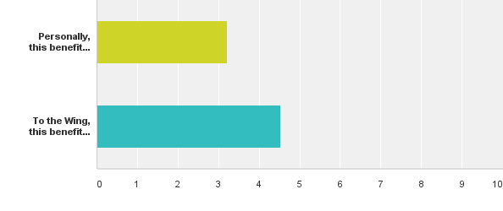
Q18: Liability Insurance - Wings have the option of piggy-backing at no cost on the RCAF Association's liability insurance policy, whenever Wing members wish to conduct an event for which they require such insurance coverage.
Answered: 421 Skipped: 777

Slide 32
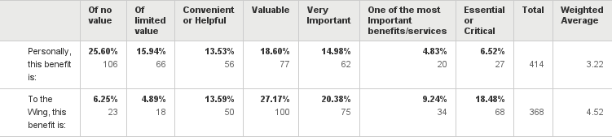
Q18: Liability Insurance - Wings have the option of piggy-backing at no cost on the RCAF Association's liability insurance policy, whenever Wing members wish to conduct an event for which they require such insurance coverage.
Answered: 421 Skipped: 777

Slide 33
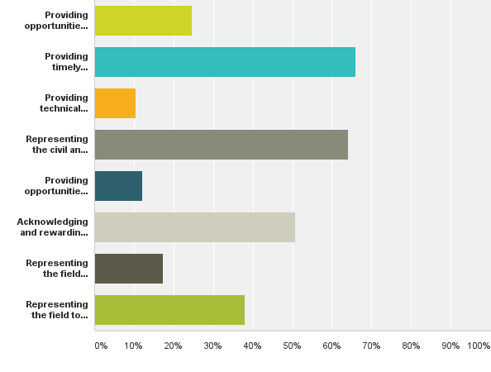
Q19: What do you think are the most important functions of an association? Select only those three (3 only) which you believe to be the most important.
Answered: 432 Skipped: 766

Slide 34
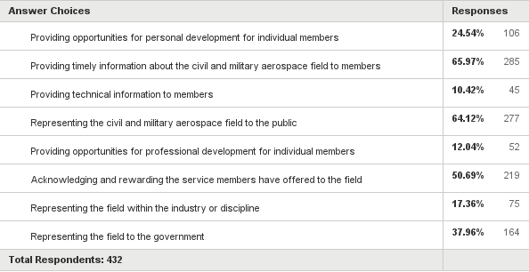
Q19: What do you think are the most important functions of an association? Select only those three (3 only) which you believe to be the most important.
Answered: 432 Skipped: 766

Slide 35
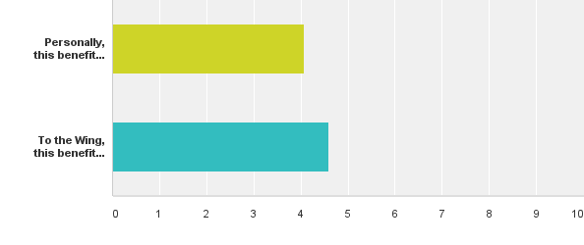
Q20: Informational Material - Internal to the Association (Publications). Wing newsletters or bulletins, Association and/or e-newsletters, pamphlets, brochures and pocket guides are distributed to help members in their various association roles, as well as in ceremonial and other roles they may be asked to fulfil outside the association in support of other organizations, such as ANAVETS and the Royal Canadian Legion.
Answered: 428 Skipped: 770

Slide 36
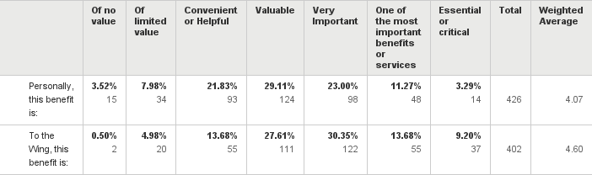
Q20: Informational Material - Internal to the Association (Publications). Wing newsletters or bulletins, Association and/or e-newsletters, pamphlets, brochures and pocket guides are distributed to help members in their various association roles, as well as in ceremonial and other roles they may be asked to fulfil outside the association in support of other organizations, such as ANAVETS and the Royal Canadian Legion.
Answered: 428 Skipped: 770

Slide 37
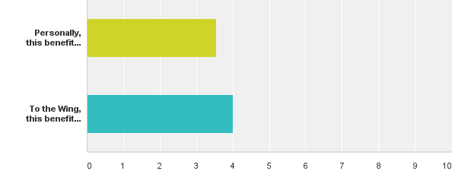
Q21: Informational Material - National Publications. Very often the RCAF Association can secure copies of formal publications issued by the government of Canada through the Department of National Defence, including the RCAF Journal, Flight Comment, monographs such as On Windswept Heights, doctrine manuals, Base newspapers, and CrewBrief, to name but a few. (Some of these have been digitized. Members may request copies, for the cost of shipping and handling only).
Answered: 425 Skipped: 773

Slide 38
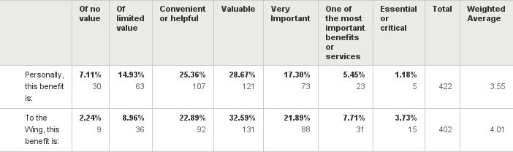
Q21: Informational Material - National Publications. Very often the RCAF Association can secure copies of formal publications issued by the government of Canada through the Department of National Defence, including the RCAF Journal, Flight Comment, monographs such as On Windswept Heights, doctrine manuals, Base newspapers, and CrewBrief, to name but a few. (Some of these have been digitized. Members may request copies, for the cost of shipping and handling only).
Answered: 425 Skipped: 773

Slide 39
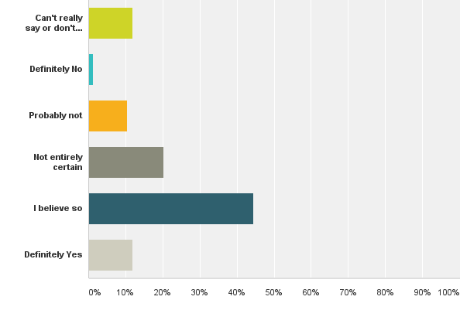
Q22: Do you believe associations like ours are capable of addressing the practical needs of individual members?
Answered: 431 Skipped: 767

Slide 40
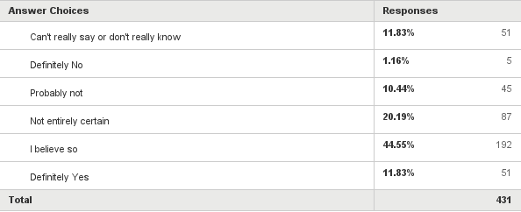
Q22: Do you believe associations like ours are capable of addressing the practical needs of individual members?
Answered: 431 Skipped: 767

Slide 41
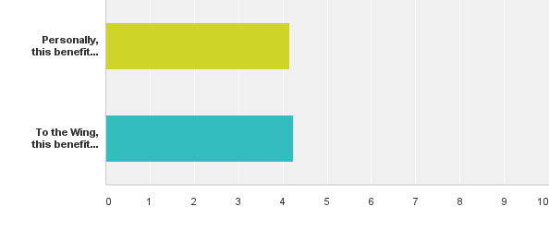
Q23: Airforce Magazine - The 64-page quarterly magazine is crafted by members for members, and consists of air force news, feature stories, reminiscences, historical commemorations, Last Postings, Association news, job postings, event announcements, and other information all designed to provide expressive and purposive incentives consistent with the association's aims and objectives.
Answered: 433 Skipped: 765

Slide 42
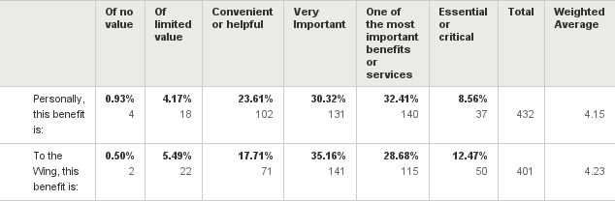
Q23: Airforce Magazine - The 64-page quarterly magazine is crafted by members for members, and consists of air force news, feature stories, reminiscences, historical commemorations, Last Postings, Association news, job postings, event announcements, and other information all designed to provide expressive and purposive incentives consistent with the association's aims and objectives.
Answered: 433 Skipped: 765

Slide 43
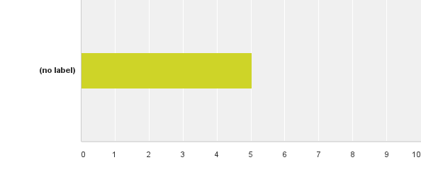
Q24: I prefer to do my own thing
Answered: 406 Skipped: 792

Slide 44
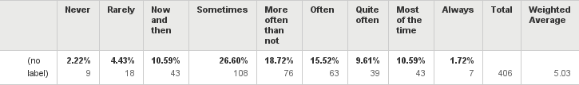
Q24: I prefer to do my own thing
Answered: 406 Skipped: 792

Slide 45

Q25: Coordination Amongst and With Other Organizations (Conference of Defence Associations, Royal Canadian Legion, Air Cadet League of Canada, National Coalition of Veterans Associations, Royal United Services Institute, Canadian Aviation Historical Society, Canadian Aviation Artists Association, Retired Airline Pilots of Canada, Transport Canada, Canadian Society of Association Executives, Army-Navy-Air Force Veterans, etc...) Since the RCAF Association is affiliated with these and other similar organizations, RCAF Association members may see a benefit to keeping abreast with the activities of these other organizations.
Answered: 429 Skipped: 769

Slide 46
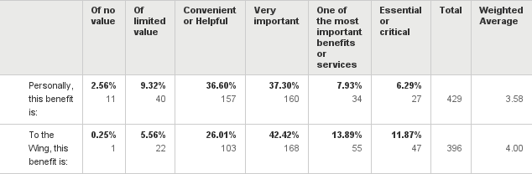
Q25: Coordination Amongst and With Other Organizations (Conference of Defence Associations, Royal Canadian Legion, Air Cadet League of Canada, National Coalition of Veterans Associations, Royal United Services Institute, Canadian Aviation Historical Society, Canadian Aviation Artists Association, Retired Airline Pilots of Canada, Transport Canada, Canadian Society of Association Executives, Army-Navy-Air Force Veterans, etc...) Since the RCAF Association is affiliated with these and other similar organizations, RCAF Association members may see a benefit to keeping abreast with the activities of these other organizations.
Answered: 429 Skipped: 769

Slide 47
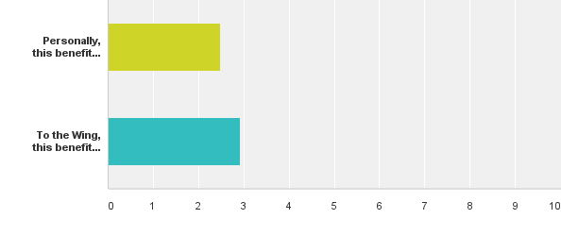
Q26: Affinity Programs - TD Home & Auto Insurance. Special discounts are offered only to RCAF Association members.
Answered: 432 Skipped: 766

Slide 48
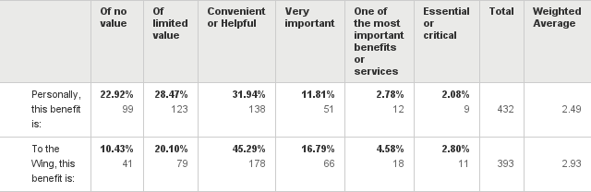
Q26: Affinity Programs - TD Home & Auto Insurance. Special discounts are offered only to RCAF Association members.
Answered: 432 Skipped: 766

Slide 49
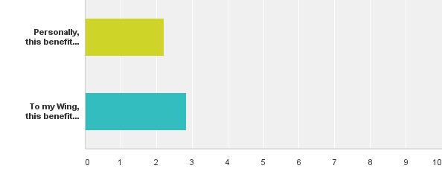
Q27: Job Notifications - Resume Posting. Employers often come to the RCAF Association looking for people (members) with specific skills, and these notices are communicated to all members through the Association's (Client-Customer) Management System or AMS (On-line Secure Database with e-Marketing and e-Notification Support Module). Additionally, our Content-Management-System-type (CMS) website is of the type all members are permitted to access. With a username and password each and every individual member can create, manage, change and add however many web-pages they wish to add, to suit their membership purposes. One such purpose is the uploading of a personal resume.
Answered: 427 Skipped: 771

Slide 50

Q27: Job Notifications - Resume Posting. Employers often come to the RCAF Association looking for people (members) with specific skills, and these notices are communicated to all members through the Association's (Client-Customer) Management System or AMS (On-line Secure Database with e-Marketing and e-Notification Support Module). Additionally, our Content-Management-System-type (CMS) website is of the type all members are permitted to access. With a username and password each and every individual member can create, manage, change and add however many web-pages they wish to add, to suit their membership purposes. One such purpose is the uploading of a personal resume.
Answered: 427 Skipped: 771

Slide 51
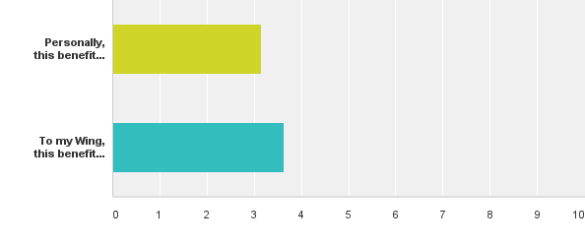
Q28: Notice of Air Force and Air Power Conferences, Seminars, Reunions, Meetings, and other Events, including Wing Events. Notice is distributed through the RCAF Association AMS e-mail system, or the Multiview e-Newsletter, Airforce magazine, and Wing newsletters or bulletins and all of the RCAF Association's social-media tools (facebook, twitter, pinterest, instagram, and LinkedIn).
Answered: 428 Skipped: 770

Slide 52

Q28: Notice of Air Force and Air Power Conferences, Seminars, Reunions, Meetings, and other Events, including Wing Events. Notice is distributed through the RCAF Association AMS e-mail system, or the Multiview e-Newsletter, Airforce magazine, and Wing newsletters or bulletins and all of the RCAF Association's social-media tools (facebook, twitter, pinterest, instagram, and LinkedIn).
Answered: 428 Skipped: 770

Slide 53
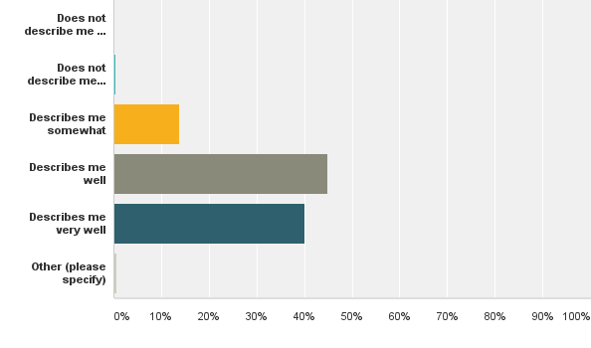
Q29: Select the best answer choice from the options below, to the following statement: I feel good when I cooperate with others.
Answered: 429 Skipped: 769

Slide 54
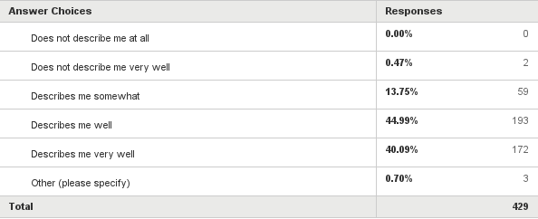
Q29: Select the best answer choice from the options below, to the following statement: I feel good when I cooperate with others.
Answered: 429 Skipped: 769

Slide 55
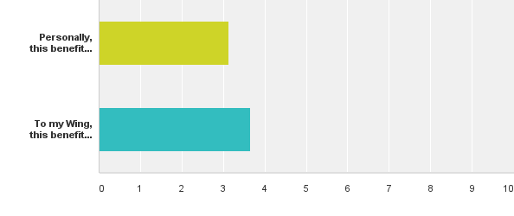
Q30: Professional Contacts and Networking. Since associations are created as venues for like-minded people to share their common identity and experiences, it is understandable that they facilitate connecting similarly-skilled professionals and people with similar interests, while providing the means to network, share experiences, ideas, interests and plans.
Answered: 429 Skipped: 769

Slide 56

Q30: Professional Contacts and Networking. Since associations are created as venues for like-minded people to share their common identity and experiences, it is understandable that they facilitate connecting similarly-skilled professionals and people with similar interests, while providing the means to network, share experiences, ideas, interests and plans.
Answered: 429 Skipped: 769

Slide 57
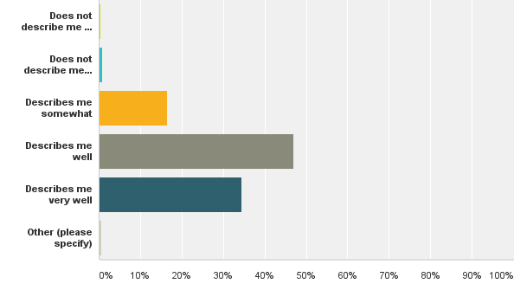
Q31: Select the best answer choice from the options below, to the following statement: My abilities contribute a great deal to my success.
Answered: 428 Skipped: 770

Slide 58
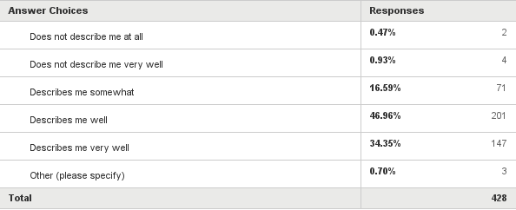
Q31: Select the best answer choice from the options below, to the following statement: My abilities contribute a great deal to my success.
Answered: 428 Skipped: 770

Slide 59

Q32: Advocacy (Air Force and Air Power Capabilities). Sharing experiences and identity, ideas and interests leads to a desire to help follow-on generations confront challenges with ideas that have worked before. Since national air power is an ever-expanding endeavour, requiring knowledge and skill sets from many, the members of the RCAF Association enjoy advocating for a well-prepared, well-trained, well-equipped air force. The RCAF Association provides the venue and platform, resources, and knowledge, means and encouragement to provide assistance to those in a position to shape the future capabilities of Canada's military air power capabilities.
Answered: 427 Skipped: 771

Slide 60

Q32: Advocacy (Air Force and Air Power Capabilities). Sharing experiences and identity, ideas and interests leads to a desire to help follow-on generations confront challenges with ideas that have worked before. Since national air power is an ever-expanding endeavour, requiring knowledge and skill sets from many, the members of the RCAF Association enjoy advocating for a well-prepared, well-trained, well-equipped air force. The RCAF Association provides the venue and platform, resources, and knowledge, means and encouragement to provide assistance to those in a position to shape the future capabilities of Canada's military air power capabilities.
Answered: 427 Skipped: 771

Slide 61

Q33: Advocacy (Air Force and Canadian Forces Veteran Support). At the Annual General Meeting in 2013, with the encouragement of members from 428 Wing Peterborough, members of the RCAF Association expressed an interest in being able to advocate for and support veterans in their communities - especially where traditional (Royal Canadian Legion) support may no longer be as readily available as it once had been.
Answered: 421 Skipped: 777

Slide 62

Q33: Advocacy (Air Force and Canadian Forces Veteran Support). At the Annual General Meeting in 2013, with the encouragement of members from 428 Wing Peterborough, members of the RCAF Association expressed an interest in being able to advocate for and support veterans in their communities - especially where traditional (Royal Canadian Legion) support may no longer be as readily available as it once had been.
Answered: 421 Skipped: 777

Slide 63

Q34: Advocacy for and Support to the Royal Canadian Air Cadet Program. The RCAF Association supports cadets financially, with three annual $2,500 continuation-flying-training bursaries, a professional wrist watch to the top-performing band cadet, donations from Wings exceeding $10,000 annually, RCAF Association Air Cadet Flight Training medals, and leadership and support for and through sponsoring and parent committees.
Answered: 427 Skipped: 771

Slide 64

Q34: Advocacy for and Support to the Royal Canadian Air Cadet Program. The RCAF Association supports cadets financially, with three annual $2,500 continuation-flying-training bursaries, a professional wrist watch to the top-performing band cadet, donations from Wings exceeding $10,000 annually, RCAF Association Air Cadet Flight Training medals, and leadership and support for and through sponsoring and parent committees.
Answered: 427 Skipped: 771

Slide 65

Q35: Representation before Government. The RCAF Association offers assistance to and dialogues with government representatives at the municipal, provincial and federal levels, for the benefit of individual members, air force veterans and Wings. Wing efforts to secure provincial grants lead provincial government officials to seek validation from the RCAF Association national office, as well as other information and support that might help the Wing's cause. Helping members of parliament with questions regarding Canada's aerospace industry, and air force, also feature in this service.
Answered: 422 Skipped: 776

Slide 66

Q35: Representation before Government. The RCAF Association offers assistance to and dialogues with government representatives at the municipal, provincial and federal levels, for the benefit of individual members, air force veterans and Wings. Wing efforts to secure provincial grants lead provincial government officials to seek validation from the RCAF Association national office, as well as other information and support that might help the Wing's cause. Helping members of parliament with questions regarding Canada's aerospace industry, and air force, also feature in this service.
Answered: 422 Skipped: 776

Slide 67

Q36: I'd rather depend on myself than on others.
Answered: 415 Skipped: 783

Slide 68

Q36: I'd rather depend on myself than on others.
Answered: 415 Skipped: 783

Slide 69

Q37: Affiliation with other Defence & Security Associations. (Conference of Defence Associations, Air Cadet League of Canada, Royal Canadian Legion, Royal United Services Institute, National Coalition of Veterans Associations, Veterans Consultation Group, and ANAVETS...)
Answered: 421 Skipped: 777

Slide 70

Q37: Affiliation with other Defence & Security Associations. (Conference of Defence Associations, Air Cadet League of Canada, Royal Canadian Legion, Royal United Services Institute, National Coalition of Veterans Associations, Veterans Consultation Group, and ANAVETS...)
Answered: 421 Skipped: 777

Slide 71

Q38: Access to Special Facilities and Services with RCAF Association membership card. Some of our members have explained they gain access to domestic (local) and international military facilities with a valid membership card, or they enjoy discounts through other organizations, using their membership card.
Answered: 421 Skipped: 777

Slide 72

Q38: Access to Special Facilities and Services with RCAF Association membership card. Some of our members have explained they gain access to domestic (local) and international military facilities with a valid membership card, or they enjoy discounts through other organizations, using their membership card.
Answered: 421 Skipped: 777

Slide 73

Q39: Select the best answer choice from the options below, to the following statement: I like my privacy.
Answered: 421 Skipped: 777

Slide 74

Q39: Select the best answer choice from the options below, to the following statement: I like my privacy.
Answered: 421 Skipped: 777

Slide 75

Q40: Research and Historical Query Support. The RCAF Association receives up to 250 queries annually, via telephone, e-mail, and letters from other researchers, family members, and interested citizens, looking for veterans, or information about veterans, and past military actions.
Answered: 421 Skipped: 777

Slide 76

Q40: Research and Historical Query Support. The RCAF Association receives up to 250 queries annually, via telephone, e-mail, and letters from other researchers, family members, and interested citizens, looking for veterans, or information about veterans, and past military actions.
Answered: 421 Skipped: 777

Slide 77

Q41: Representation and Support with the Media. News (print and TV and Radio) media agencies routinely require access to air force veterans, and they come to the RCAF Association with their requests. We put them in touch with the right members, based on the needs of the media. We also provide expert responses to stories and features that make it into the news, and which require our attention, on your behalf.
Answered: 419 Skipped: 779

Slide 78

Q41: Representation and Support with the Media. News (print and TV and Radio) media agencies routinely require access to air force veterans, and they come to the RCAF Association with their requests. We put them in touch with the right members, based on the needs of the media. We also provide expert responses to stories and features that make it into the news, and which require our attention, on your behalf.
Answered: 419 Skipped: 779

Slide 79

Q42: Kitshop and Military Regalia. As a unique arm of the uniformed services, RCAF veterans prefer distinctive regalia appropriate to and respectful of RCAF traditions. Validation by an entity like the RCAF Association confirms acceptance and conveys legitimacy, for the benefit of its members.
Answered: 421 Skipped: 777

Slide 80

Q42: Kitshop and Military Regalia. As a unique arm of the uniformed services, RCAF veterans prefer distinctive regalia appropriate to and respectful of RCAF traditions. Validation by an entity like the RCAF Association confirms acceptance and conveys legitimacy, for the benefit of its members.
Answered: 421 Skipped: 777

Slide 81

Q43: Legal Advice and Accounting Advice for Small-Businesses. The employment of professionally-educated and/or certified staff members or access to similarly-qualified agents/consultants provides an important source for the advice sought.
Answered: 422 Skipped: 776

Slide 82

Q43: Legal Advice and Accounting Advice for Small-Businesses. The employment of professionally-educated and/or certified staff members or access to similarly-qualified agents/consultants provides an important source for the advice sought.
Answered: 422 Skipped: 776

Slide 83

Q44: Provision of a Charter, for the Wing. A Charter bestows upon the Wing the privilege of using workmarks and trademarks including "RCAF" and logos (roundel), the RCAF Association ensign, and symbols (RCAF heraldic crest) in exchange for assurances the Wing and its members will treat such wordmarks and trademarks appropriately. Permissions are extended to the RCAF Association, which pays for these copyright access privileges so that the Wings can enjoy the privileges free of charge. Without the Charter, Wings have no rights to the use of any wordmarks and trademarks related to the RCAF.
Answered: 420 Skipped: 778

Slide 84

Q44: Provision of a Charter, for the Wing. A Charter bestows upon the Wing the privilege of using workmarks and trademarks including "RCAF" and logos (roundel), the RCAF Association ensign, and symbols (RCAF heraldic crest) in exchange for assurances the Wing and its members will treat such wordmarks and trademarks appropriately. Permissions are extended to the RCAF Association, which pays for these copyright access privileges so that the Wings can enjoy the privileges free of charge. Without the Charter, Wings have no rights to the use of any wordmarks and trademarks related to the RCAF.
Answered: 420 Skipped: 778

Slide 85

Q45: Camaraderie, Fellowship and Friendship.
Answered: 420 Skipped: 778

Slide 86

Q45: Camaraderie, Fellowship and Friendship.
Answered: 420 Skipped: 778

Slide 87

Q46: Co-ordination with Other Organizations. Our fellow organizations rely on the RCAF Association for support and participation. For example, the laying of a wreath on behalf of the members of the RCAF Association, at the national Remembrance Day celebration, is a matter of co-ordination and privilege extended to the RCAF Association through our ties with the Royal Canadian Legion.
Answered: 420 Skipped: 778

Slide 88

Q46: Co-ordination with Other Organizations. Our fellow organizations rely on the RCAF Association for support and participation. For example, the laying of a wreath on behalf of the members of the RCAF Association, at the national Remembrance Day celebration, is a matter of co-ordination and privilege extended to the RCAF Association through our ties with the Royal Canadian Legion.
Answered: 420 Skipped: 778

Slide 89

Q47: Central Administrative Support. The ability to operate under the RCAF Association umbrella provides a central office Wings can use to pool resources, including financial, for the operational and charitable (RCAF Association Trust Fund) activities they pursue. Wings can pool funds, if desired, and Wings in need can access pooled funds to meet unexpected repairs, expansions, and other similar needs.
Answered: 420 Skipped: 778

Slide 90

Q47: Central Administrative Support. The ability to operate under the RCAF Association umbrella provides a central office Wings can use to pool resources, including financial, for the operational and charitable (RCAF Association Trust Fund) activities they pursue. Wings can pool funds, if desired, and Wings in need can access pooled funds to meet unexpected repairs, expansions, and other similar needs.
Answered: 420 Skipped: 778

Slide 91

Q48: Honours & Awards. Each year a significant number of members receive special recognition for their work and community support. Some of the awards are extended to members through the Minister of Veterans Affairs, the Commander RCAF and the Chief of the Defence Staff. The honours and awards that are provided by the association help retain and recruit members into the association, keeping the association strong and thriving. Some of the awards include Life Membership, Meritorious or Distinguished Service, etc...
Answered: 422 Skipped: 776

Slide 92

Q48: Honours & Awards. Each year a significant number of members receive special recognition for their work and community support. Some of the awards are extended to members through the Minister of Veterans Affairs, the Commander RCAF and the Chief of the Defence Staff. The honours and awards that are provided by the association help retain and recruit members into the association, keeping the association strong and thriving. Some of the awards include Life Membership, Meritorious or Distinguished Service, etc...
Answered: 422 Skipped: 776

Slide 93

Q49: Personal Growth and Leadership Experience. Those in need of enhancing personal attributes, training, education, social involvement and leadership skills, benefit from their participation and volunteerism in the RCAF Association
Answered: 421 Skipped: 777

Slide 94

Q49: Personal Growth and Leadership Experience. Those in need of enhancing personal attributes, training, education, social involvement and leadership skills, benefit from their participation and volunteerism in the RCAF Association
Answered: 421 Skipped: 777

Slide 95

Q50: Civic involvement, Community Improvement, Political Participation, Strengthening our Democracy through Active Support and Engagement
Answered: 422 Skipped: 776

Slide 96

Q50: Civic involvement, Community Improvement, Political Participation, Strengthening our Democracy through Active Support and Engagement
Answered: 422 Skipped: 776

Slide 97

Q51: Membership provides you with access to the most up-to-date information available in your field. (By field we mean the civilian and military aerospace trades).
Answered: 419 Skipped: 779

Slide 98

Q51: Membership provides you with access to the most up-to-date information available in your field. (By field we mean the civilian and military aerospace trades).
Answered: 419 Skipped: 779

Slide 99

Q52: Competition is natural - it is the law of nature.
Answered: 416 Skipped: 782

Slide 100

Q52: Competition is natural - it is the law of nature.
Answered: 416 Skipped: 782

Slide 101

Q53: Membership provides you with opportunities to network with other similarly-minded professionals in your field (civilian or military aerospace fields, or any relevant field evident in your community and your Wing)
Answered: 420 Skipped: 778

Slide 102

Q53: Membership provides you with opportunities to network with other similarly-minded professionals in your field (civilian or military aerospace fields, or any relevant field evident in your community and your Wing)
Answered: 420 Skipped: 778

Slide 103

Q54: Democracies like Canada encourage participation in democratic and civil/civic activities; serving as a Wing executive member is an opportunity to gain leadership experience and thus offer something more to your community and strengthen Canadian democracy.
Answered: 416 Skipped: 782

Slide 104

Q54: Democracies like Canada encourage participation in democratic and civil/civic activities; serving as a Wing executive member is an opportunity to gain leadership experience and thus offer something more to your community and strengthen Canadian democracy.
Answered: 416 Skipped: 782

Slide 105

Q55: My personal identity, independent of others, is very important to me
Answered: 416 Skipped: 782

Slide 106

Q55: My personal identity, independent of others, is very important to me
Answered: 416 Skipped: 782

Slide 107

Q56: Serving in a leadership capacity provides you with a reference directory of members/practitioners and professional counterparts and friends.
Answered: 416 Skipped: 782

Slide 108

Q56: Serving in a leadership capacity provides you with a reference directory of members/practitioners and professional counterparts and friends.
Answered: 416 Skipped: 782

Slide 109

Q57: Membership provides member discounts or Wing discounts.
Answered: 416 Skipped: 782

Slide 110

Q57: Membership provides member discounts or Wing discounts.
Answered: 416 Skipped: 782

Slide 111

Q58: It is important to me that I respect the decisions made by my groups.
Answered: 415 Skipped: 783

Slide 112

Q58: It is important to me that I respect the decisions made by my groups.
Answered: 415 Skipped: 783

Slide 113

Q59: Membership gives me a chance to help promote a greater appreciation of the role and value of the civil and military aerospace field among practitioners.
Answered: 418 Skipped: 780

Slide 114

Q59: Membership gives me a chance to help promote a greater appreciation of the role and value of the civil and military aerospace field among practitioners.
Answered: 418 Skipped: 780

Slide 115

Q60: Membership provides me with access to special products, tailored services, important programs, and unique suppliers (insurance, publications, knowledge products,...)
Answered: 419 Skipped: 779

Slide 116

Q60: Membership provides me with access to special products, tailored services, important programs, and unique suppliers (insurance, publications, knowledge products,...)
Answered: 419 Skipped: 779

Slide 117

Q61: Leading a Wing gives me the opportunity to attract competent people into the RCAF Association, for the benefit of the civil and military aerospace field.
Answered: 408 Skipped: 790

Slide 118

Q61: Leading a Wing gives me the opportunity to attract competent people into the RCAF Association, for the benefit of the civil and military aerospace field.
Answered: 408 Skipped: 790

Slide 119

Q62: A leadership role in the RCAF Association provides me with the opportunity to provide awards and recognition for excellence in the civil and military aerospace field.
Answered: 405 Skipped: 793

Slide 120

Q62: A leadership role in the RCAF Association provides me with the opportunity to provide awards and recognition for excellence in the civil and military aerospace field.
Answered: 405 Skipped: 793

Slide 121

Q63: Service in the RCAF Association permits me the opportunity to promote greater public awareness of contributions in the civil and military aerospace field
Answered: 410 Skipped: 788

Slide 122

Q63: Service in the RCAF Association permits me the opportunity to promote greater public awareness of contributions in the civil and military aerospace field
Answered: 410 Skipped: 788

Slide 123

Q64: Select the best answer choice from the options below, to the following statement: The well-being of ALL my fellow Wing members is important to me.
Answered: 416 Skipped: 782

Slide 124

Q64: Select the best answer choice from the options below, to the following statement: The well-being of ALL my fellow Wing members is important to me.
Answered: 416 Skipped: 782

Slide 125

Q65: Select the best answer choice from the options below, to the following statement: When a fellow Wing-member earns an RCAF Association award, I feel immense pride.
Answered: 412 Skipped: 786

Slide 126

Q65: Select the best answer choice from the options below, to the following statement: When a fellow Wing-member earns an RCAF Association award, I feel immense pride.
Answered: 412 Skipped: 786

Slide 127

Q66: Select the best answer choice from the options below, to the following statement: It is imperative to maintain harmony within my Wing.
Answered: 412 Skipped: 786

Slide 128

Q66: Select the best answer choice from the options below, to the following statement: It is imperative to maintain harmony within my Wing.
Answered: 412 Skipped: 786

Slide 129

Q67: Select the best answer choice from the options below, to the following statement: My happiness depends to a great extent on the happiness of my fellow Wing members.
Answered: 411 Skipped: 787

Slide 130

Q67: Select the best answer choice from the options below, to the following statement: My happiness depends to a great extent on the happiness of my fellow Wing members.
Answered: 411 Skipped: 787

Slide 131

Q68: Select the best answer choice from the options below, to the following statement: I enjoy being different and unique from others in many ways.
Answered: 414 Skipped: 784

Slide 132

Q68: Select the best answer choice from the options below, to the following statement: I enjoy being different and unique from others in many ways.
Answered: 414 Skipped: 784

Slide 133

Q69: Select the best answer choice from the options below, to the following statement: To me, pleasure is spending time with others.
Answered: 415 Skipped: 783

Slide 134

Q69: Select the best answer choice from the options below, to the following statement: To me, pleasure is spending time with others.
Answered: 415 Skipped: 783

Slide 135

Q70: Select the best answer choice from the options below, to the following statement: I prefer to be direct and forthright, when discussing things with my fellow Wing Executive members and others.
Answered: 414 Skipped: 784

Slide 136

Q70: Select the best answer choice from the options below, to the following statement: I prefer to be direct and forthright, when discussing things with my fellow Wing Executive members and others.
Answered: 414 Skipped: 784

Slide 137

Q71: It is important that I do my job better than others.
Answered: 404 Skipped: 794

Slide 138

Q71: It is important that I do my job better than others.
Answered: 404 Skipped: 794

Slide 139

Q72: Winning is everything.
Answered: 411 Skipped: 787

Slide 140

Q72: Winning is everything.
Answered: 411 Skipped: 787

Slide 141

Q73: What digital (computer) skills do you believe everyone in your Wing needs now? (Select all you feel apply)
Answered: 411 Skipped: 787

Slide 142

Q73: What digital (computer) skills do you believe everyone in your Wing needs now? (Select all you feel apply)
Answered: 411 Skipped: 787

Slide 143

Q74: How effective have you found the following communication methods for informing and learning from your members what they think, need and want?
Answered: 415 Skipped: 783

Slide 144

Q74: How effective have you found the following communication methods for informing and learning from your members what they think, need and want?
Answered: 415 Skipped: 783

Slide 145

Q76: How effective have you found the following means of communication?
Answered: 530 Skipped: 668

Slide 146

Q76: How effective have you found the following means of communication?
Answered: 530 Skipped: 668

Slide 147

Q77: Choose from the options, below, how you feel about the following definition of the word membership: in exchange for their annual dues members benefit from a unique package of products and services they themselves help design, as a consequence of their desire to help shape the future affairs of their association
Answered: 518 Skipped: 680

Slide 148

Q77: Choose from the options, below, how you feel about the following definition of the word membership: in exchange for their annual dues members benefit from a unique package of products and services they themselves help design, as a consequence of their desire to help shape the future affairs of their association
Answered: 518 Skipped: 680

Slide 149

Q78: Do you believe associations like ours are capable of addressing the practical needs of individual members?
Answered: 528 Skipped: 670

Slide 150

Q78: Do you believe associations like ours are capable of addressing the practical needs of individual members?
Answered: 528 Skipped: 670

Slide 151

Q79: What do you think are the most important functions of an association? Select only those three (3 only) which you believe to be the most important.
Answered: 519 Skipped: 679

Slide 152

Q79: What do you think are the most important functions of an association? Select only those three (3 only) which you believe to be the most important.
Answered: 519 Skipped: 679

Slide 153

Q80: Coordination Amongst and With Other Organizations (Conference of Defence Associations, Royal Canadian Legion, Air Cadet League of Canada, National Coalition of Veterans Associations, Royal United Services Institute, Canadian Aviation Historical Society, Canadian Aviation Artists Association, Retired Airline Pilots of Canada, Transport Canada, Canadian Society of Association Executives, Army-Navy-Air Force Veterans, etc...) Since the RCAF Association is affiliated with these and other similar organizations, RCAF Association members may see a benefit to keeping abreast with the activities of these other organizations.
Answered: 526 Skipped: 672

Slide 154

Q80: Coordination Amongst and With Other Organizations (Conference of Defence Associations, Royal Canadian Legion, Air Cadet League of Canada, National Coalition of Veterans Associations, Royal United Services Institute, Canadian Aviation Historical Society, Canadian Aviation Artists Association, Retired Airline Pilots of Canada, Transport Canada, Canadian Society of Association Executives, Army-Navy-Air Force Veterans, etc...) Since the RCAF Association is affiliated with these and other similar organizations, RCAF Association members may see a benefit to keeping abreast with the activities of these other organizations.
Answered: 526 Skipped: 672

Slide 155

Q81: Affinity Programs - TD Home & Auto Insurance. Special discounts are offered only to RCAF Association members.
Answered: 526 Skipped: 672

Slide 156

Q81: Affinity Programs - TD Home & Auto Insurance. Special discounts are offered only to RCAF Association members.
Answered: 526 Skipped: 672

Slide 157

Q82: Job Notifications - Resume Posting. Employers often come to the RCAF Association looking for people (members) with specific skills, and these notices are communicated to all members through the Association's (Client-Customer) Management System or AMS (On-line Secure Database with e-Marketing and e-Notification Support Module). Additionally, our Content-Management-System-type (CMS) website is of the type all members are permitted to access. With a username and password each and every individual member can create, manage, change and add however many web-pages they wish to add, to suit their membership purposes. One such purpose is the uploading of a personal resume.
Answered: 517 Skipped: 681

Slide 158

Q82: Job Notifications - Resume Posting. Employers often come to the RCAF Association looking for people (members) with specific skills, and these notices are communicated to all members through the Association's (Client-Customer) Management System or AMS (On-line Secure Database with e-Marketing and e-Notification Support Module). Additionally, our Content-Management-System-type (CMS) website is of the type all members are permitted to access. With a username and password each and every individual member can create, manage, change and add however many web-pages they wish to add, to suit their membership purposes. One such purpose is the uploading of a personal resume.
Answered: 517 Skipped: 681

Slide 159

Q83: Notice of Air Force and Air Power Conferences, Seminars, Reunions, Meetings, and other Events, including Wing Events. Notice is distributed through the RCAF Association AMS e-mail system, or the Multiview e-Newsletter, Airforce magazine, and Wing newsletters or bulletins and all of the RCAF Association's social-media tools (facebook, twitter, pinterest, instagram, and LinkedIn).
Answered: 525 Skipped: 673

Slide 160

Q83: Notice of Air Force and Air Power Conferences, Seminars, Reunions, Meetings, and other Events, including Wing Events. Notice is distributed through the RCAF Association AMS e-mail system, or the Multiview e-Newsletter, Airforce magazine, and Wing newsletters or bulletins and all of the RCAF Association's social-media tools (facebook, twitter, pinterest, instagram, and LinkedIn).
Answered: 525 Skipped: 673

Slide 161

Q84: Select the best answer choice from the options below, to the following statement: I feel good when I cooperate with others.
Answered: 526 Skipped: 672

Slide 162

Q84: Select the best answer choice from the options below, to the following statement: I feel good when I cooperate with others.
Answered: 526 Skipped: 672

Slide 163

Q85: Professional Contacts and Networking. Since associations are created as venues for like-minded people to share their common identity and experiences, it is understandable that they facilitate connecting similarly-skilled professionals and people with similar interests, while providing the means to network, share experiences, ideas, interests and plans.
Answered: 527 Skipped: 671

Slide 164

Q85: Professional Contacts and Networking. Since associations are created as venues for like-minded people to share their common identity and experiences, it is understandable that they facilitate connecting similarly-skilled professionals and people with similar interests, while providing the means to network, share experiences, ideas, interests and plans.
Answered: 527 Skipped: 671

Slide 165

Q86: Select the best answer choice from the options below, to the following statement: My abilities contribute a great deal to my success.
Answered: 527 Skipped: 671

Slide 166

Q86: Select the best answer choice from the options below, to the following statement: My abilities contribute a great deal to my success.
Answered: 527 Skipped: 671

Slide 167

Q87: Advocacy (Air Force and Air Power Capabilities). Sharing experiences and identity, ideas and interests leads to a desire to help follow-on generations confront challenges with ideas that have worked before. Since national air power is an ever-expanding endeavour, requiring knowledge and skill sets from many, the members of the RCAF Association enjoy advocating for a well-prepared, well-trained, well-equipped air force. The RCAF Association provides the venue and platform, resources, and knowledge, means and encouragement to provide assistance to those in a position to shape the future capabilities of Canada's military air power capabilities.
Answered: 529 Skipped: 669

Slide 168

Q87: Advocacy (Air Force and Air Power Capabilities). Sharing experiences and identity, ideas and interests leads to a desire to help follow-on generations confront challenges with ideas that have worked before. Since national air power is an ever-expanding endeavour, requiring knowledge and skill sets from many, the members of the RCAF Association enjoy advocating for a well-prepared, well-trained, well-equipped air force. The RCAF Association provides the venue and platform, resources, and knowledge, means and encouragement to provide assistance to those in a position to shape the future capabilities of Canada's military air power capabilities.
Answered: 529 Skipped: 669

Slide 169

Q88: Advocacy for and Support to the Royal Canadian Air Cadet Program. The RCAF Association supports cadets financially, with three annual $2,500 continuation-flying-training bursaries, a professional wrist watch to the top-performing band cadet, donations from Wings exceeding $10,000 annually, RCAF Association Air Cadet Flight Training medals, and leadership and support for and through sponsoring and parent committees.
Answered: 527 Skipped: 671

Slide 170

Q88: Advocacy for and Support to the Royal Canadian Air Cadet Program. The RCAF Association supports cadets financially, with three annual $2,500 continuation-flying-training bursaries, a professional wrist watch to the top-performing band cadet, donations from Wings exceeding $10,000 annually, RCAF Association Air Cadet Flight Training medals, and leadership and support for and through sponsoring and parent committees.
Answered: 527 Skipped: 671

Slide 171
Q89: Advocacy for and Support to the Royal Canadian Air Cadet Program. The RCAF Association supports cadets financially, with three annual $2,500 continuation-flying-training bursaries, a professional wrist watch to the top-performing band cadet, donations from Wings exceeding $10,000 annually, RCAF Association Air Cadet Flight Training medals, and leadership and support for and through sponsoring and parent committees.
Answered: 509 Skipped: 689

Slide 172

Q89: Advocacy for and Support to the Royal Canadian Air Cadet Program. The RCAF Association supports cadets financially, with three annual $2,500 continuation-flying-training bursaries, a professional wrist watch to the top-performing band cadet, donations from Wings exceeding $10,000 annually, RCAF Association Air Cadet Flight Training medals, and leadership and support for and through sponsoring and parent committees.
Answered: 509 Skipped: 689

Slide 173

Q90: Professional Contacts and Networking. Since associations are created as venues for like-minded people to share their common identity and experiences, it is understandable that they facilitate connecting similarly-skilled professionals and people with similar interests, while providing the means to network, share experiences, ideas, interests and plans.
Answered: 521 Skipped: 677

Slide 174

Q90: Professional Contacts and Networking. Since associations are created as venues for like-minded people to share their common identity and experiences, it is understandable that they facilitate connecting similarly-skilled professionals and people with similar interests, while providing the means to network, share experiences, ideas, interests and plans.
Answered: 521 Skipped: 677

Slide 175
Q91: Access to Special Facilities and Services with RCAF Association membership card. Some of our members have explained they gain access to domestic (local) and international military facilities with a valid membership card, or they enjoy discounts through other organizations, using their membership card.
Answered: 524 Skipped: 674

Slide 176

Q91: Access to Special Facilities and Services with RCAF Association membership card. Some of our members have explained they gain access to domestic (local) and international military facilities with a valid membership card, or they enjoy discounts through other organizations, using their membership card.
Answered: 524 Skipped: 674

Slide 177

Q92: Research and Historical Query Support. The RCAF Association receives up to 250 queries annually, via telephone, e-mail, and letters from other researchers, surviving family members, and interested citizens, looking for veterans, or information about veterans, and past military actions.
Answered: 523 Skipped: 675

Slide 178

Q92: Research and Historical Query Support. The RCAF Association receives up to 250 queries annually, via telephone, e-mail, and letters from other researchers, surviving family members, and interested citizens, looking for veterans, or information about veterans, and past military actions.
Answered: 523 Skipped: 675

Slide 179
Q93: Representation and Support with the Media. News (print and TV and Radio) media agencies routinely require access to air force veterans, and they come to the RCAF Association with their requests. We put them in touch with the right members, based on the needs of the media. We also provide expert responses to stories and features that make it into the news, and which require our attention, on your behalf.
Answered: 525 Skipped: 673

Slide 180

Q93: Representation and Support with the Media. News (print and TV and Radio) media agencies routinely require access to air force veterans, and they come to the RCAF Association with their requests. We put them in touch with the right members, based on the needs of the media. We also provide expert responses to stories and features that make it into the news, and which require our attention, on your behalf.
Answered: 525 Skipped: 673

Slide 181

Q94: Kitshop and Military Regalia. As a unique arm of the uniformed services, RCAF veterans prefer distinctive regalia appropriate to and respectful of RCAF traditions. Validation by an entity like the RCAF Association confirms acceptance and conveys legitimacy, for the benefit of its members.
Answered: 526 Skipped: 672

Slide 182

Q94: Kitshop and Military Regalia. As a unique arm of the uniformed services, RCAF veterans prefer distinctive regalia appropriate to and respectful of RCAF traditions. Validation by an entity like the RCAF Association confirms acceptance and conveys legitimacy, for the benefit of its members.
Answered: 526 Skipped: 672

Slide 183

Q95: Camaraderie, Fellowship and Friendship.
Answered: 515 Skipped: 683

Slide 184

Q95: Camaraderie, Fellowship and Friendship.
Answered: 515 Skipped: 683

Slide 185

Q96: Co-ordination with Other Organizations. Our fellow organizations rely on the RCAF Association for support and participation. For example, the laying of a wreath on behalf of the members of the RCAF Association, at the national Remembrance Day celebration, is a matter of co-ordination and privilege extended to the RCAF Association through our ties with the Royal Canadian Legion.
Answered: 524 Skipped: 674

Slide 186

Q96: Co-ordination with Other Organizations. Our fellow organizations rely on the RCAF Association for support and participation. For example, the laying of a wreath on behalf of the members of the RCAF Association, at the national Remembrance Day celebration, is a matter of co-ordination and privilege extended to the RCAF Association through our ties with the Royal Canadian Legion.
Answered: 524 Skipped: 674

Slide 187
Q97: Honours & Awards. Each year a significant number of members receive special recognition for their work and community support. Some of the awards are extended to members through the Minister of Veterans Affairs, the Commander RCAF and the Chief of the Defence Staff. The honours and awards that are provided by the association help retain and recruit members into the association, keeping the association strong and thriving. Some of the awards include Life Membership, Meritorious or Distinguished Service, etc...
Answered: 528 Skipped: 670

Slide 188

Q97: Honours & Awards. Each year a significant number of members receive special recognition for their work and community support. Some of the awards are extended to members through the Minister of Veterans Affairs, the Commander RCAF and the Chief of the Defence Staff. The honours and awards that are provided by the association help retain and recruit members into the association, keeping the association strong and thriving. Some of the awards include Life Membership, Meritorious or Distinguished Service, etc...
Answered: 528 Skipped: 670

Slide 189

Q98: Civic involvement, Community Improvement, Political Participation, Strengthening our Democracy through Active Support and Engagement
Answered: 524 Skipped: 674

Slide 190

Q98: Civic involvement, Community Improvement, Political Participation, Strengthening our Democracy through Active Support and Engagement
Answered: 524 Skipped: 674

Slide 191

Q99: Membership provides you with access to the most up-to-date information available in your field. (By field we mean the civilian and military aerospace trades).
Answered: 522 Skipped: 676

Slide 192

Q99: Membership provides you with access to the most up-to-date information available in your field. (By field we mean the civilian and military aerospace trades).
Answered: 522 Skipped: 676

Slide 193

Q100: Membership provides you with opportunities to network with other similarly-minded professionals in your field (civilian or military aerospace fields, or any relevant field evident in your community and your Wing)
Answered: 527 Skipped: 671

Slide 194

Q100: Membership provides you with opportunities to network with other similarly-minded professionals in your field (civilian or military aerospace fields, or any relevant field evident in your community and your Wing)
Answered: 527 Skipped: 671

Slide 195
Q101: My personal identity, independent of others, is very important to me
Answered: 517 Skipped: 681

Slide 196

Q101: My personal identity, independent of others, is very important to me
Answered: 517 Skipped: 681

Slide 197

Q102: Membership gives me a chance to help promote a greater appreciation of the role and value of the civil and military aerospace field among practitioners (fellow aviators or supporters of aviation in Canada).
Answered: 520 Skipped: 678

Slide 198

Q102: Membership gives me a chance to help promote a greater appreciation of the role and value of the civil and military aerospace field among practitioners (fellow aviators or supporters of aviation in Canada).
Answered: 520 Skipped: 678

Slide 199

Q103: Membership in the RCAF Association provides me with the means to convey to Canadians the importance of their country's air force.
Answered: 523 Skipped: 675

Slide 200

Q103: Membership in the RCAF Association provides me with the means to convey to Canadians the importance of their country's air force.
Answered: 523 Skipped: 675

Slide 201

Q104: Membership provides me with access to special products, tailored services, important programs, and unique suppliers (insurance, publications, knowledge products,...)
Answered: 525 Skipped: 673

Slide 202

Q104: Membership provides me with access to special products, tailored services, important programs, and unique suppliers (insurance, publications, knowledge products,...)
Answered: 525 Skipped: 673

Slide 203
Q105: Service in the RCAF Association permits me the opportunity to promote greater public awareness of contributions in the civil and military aerospace field
Answered: 523 Skipped: 675

Slide 204

Q105: Service in the RCAF Association permits me the opportunity to promote greater public awareness of contributions in the civil and military aerospace field
Answered: 523 Skipped: 675

