Slide 1
RCAF Association Trust Fund
April/May 2018

Slide 2
Overview
Trust Fund History
Sample of Fund Beneficiaries 2017
Trust Fund Performance
Trust Fund Dilemma
Proposed Solution

Slide 3
Trust Fund History
Registered charity, established 1975
Support, assist, promote & further:
- train/educate young Canadians, particularly Air Cadets
- educate Canadians on RCAF aviation & aviation history

Slide 4
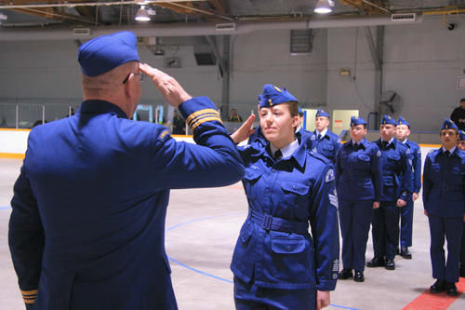
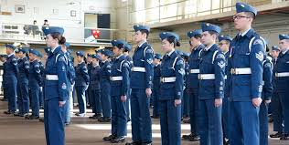
Air Cadet Support

Slide 5
International Bomber Command Centre (Lincoln)

Slide 6
Trust Fund
PAST PERFORMANCE:
Distributed over $1.5 million from 1975 to date
1989-2005 distributed $936K to 80 projects

Slide 7
Trust Fund
CURRENT PERFORMANCE:
Less than $4k required annually to cover annual Trust Fund audit (review engagement) costs;
Other administrative costs less than $1k annually;
These admin expenses seem to average about 5.6% of donations annually;
Donations declining each year, commensurate with decline in Regular membership, may not be able to sustain Trust Fund operations beyond June 30, 2019

Slide 8
Trust Fund
FUTURE?
Trust Fund needs to be reinvigorated or dissolved;
Reinvigoration ideally comes from sufficient numbers of people choosing to use (donate to) the fund;

Slide 9
Trust Fund Dilemma
End FY 2017 total non-designated funds ~$36,828
End FY 2018 total non-designated funds ~$34,264
The health of the fund is year-to-year, now – flat or shrinking growth, with a shrinking donation pool;
Last such crisis was in 2005, when worthy requests for donations/support had to be declined;
Dissolve Trust Fund or fund-generate
Member support essential for Trust Fund to continue
Progress has been marginal – not encouraging at all

Slide 10
TF Survival Strategy
In 2016 we commenced two goals:
First: raise as much as $100,000 in two years to help add to the principal in the Continuation Flying Training Awards (Air Cadet League) RCAF Association Bank Account; and
Second: raise as much as $10,000 annually in non-designated donations, to help fund non-forecast project funding requirements that emerge during the year.

Slide 11
Campaign Goal #1
From Apr 1, 2016 raise $100,000 by Dec 31, 2018
To fund Air Cadet Continuation Flying Awards (3 annual $2,500 awards from ACCF account interest)
Two problems – not enough funds and narrow eligibility application (limited to continuation flying training)
ACCF account currently has ~$249,000
We may see another $16,000 added to the account from this campaign;
TF donated $2,700 from non-designated funds to meet interest income shortfall for 2016
No non-designated funds were available to top up the Awards in 2017, thus, only one x $2,500 award given

Slide 12
Campaign Goal #1
Initial strategy was to fund Air Cadet Continuation Flying Awards (3 annual $2,500 awards from ACCF account interest)
Broadened eligibility to include specific post secondary education eligibility for the three ACCF awards
Appears will not make the $300,000 goal by end 2018

Slide 13
Campaign Goal #2
Raise $10,000 annually
For non-designated/non-forecast projects
Beneficiaries will be RCAF Association Wings, academic institutions, air cadets, aerospace preservation projects, memorials, etc.
Need entire RCAF Association membership to participate to succeed
77 members donated approximately $4K in current FY (Additional donations from CanadaHelps.org and Groups not included – amount TBA soon)

Slide 14
Campaign Methodologies
Past efforts suggested to achieve the two Goals need:
Special volunteer position at each Wing
Wing Reps to head $100K goal for 2 years
Realignment of certain NEC awards
Group Level encouragement of Wings to conduct an annual activity to raise required $10K annually
Airforce magazine could be used to reach out to members-at-large, stakeholders, RCAF & DND

Slide 15
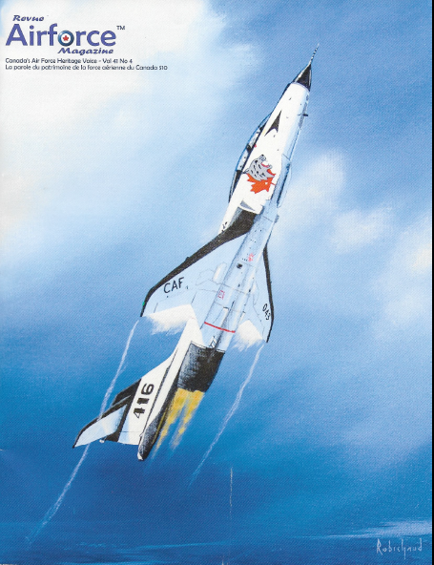

Slide 16
Methodologies cont’d
Passing the hat at annual Group meetings (Group Trustee) being done
Letters to COs to encourage RCAF members to contribute to the RCAF A Trust Fund in United Way campaigns (NEC) Is this & are next 2 being done?
Re-aligning awards since goals & methodologies lean on participation of individual members, Wings & Groups (i.e. Member of the Year, Wing of the Year and Group efficiency awards) (NEC initiate)?
Change awards criteria away from membership statistics (NEC initiate)?

Slide 17
Campaign Activities
Member/Wing Awards to reflect level of donation with recognition published on the Trust Fund website ($2500, $1000, $500, $100)
Encourage individual donations directly to the Trust Fund for the “Continuation Flying Awards” account
Lottery/gaming license (i.e. win $5k air travel voucher plus a $5K prize to Wing or supported Air Cadet Squadron – tickets $2/ea. or 3 for $5)
Wings have been requested to undertake 1 dedicated annual activity in support of the RCAFA Trust Fund

Slide 18
Campaign Activities
Consider (need to do something, we are drowning):
Special pins for Associate members who contribute a certain value and above
Encouraging donations through members’ Wills ***
Donation by every RCAFA member ($25-$50/yr)
Encourage contribution to the $100k air cadet bursary account & annually to the $10k non-designated account (Doing this right now!)

Slide 19
Campaign Activities cont’d
NEC identify stakeholders that rely on the RCAF Assn Trust Fund for their success & approach any who may be in a position to donate (NEC)
Direct mail campaigns (NEC)
Telemarketing (Wings)
Online & E-giving (Trust Fund thru Canada.helps Org)
Grants – Foundations, Corporate & Government (NEC)
United Way (NEC Coordinate)

Slide 20
Campaign Activities cont’d
Remember Fallen Aviators Ribbon
Members will recognize the tri-colour “air force” pattern on this ribbon;
An RCAF roundel pin adds a memorable touch;
We have 5,000 ribbons and pins;
They can be used to help raise funds for the RCAF Association Trust Fund air cadet-supporting activities;
Each year on or near 01 April (RCAF Birthday) we are hopeful participating Wings and supported Air Cadet Squadrons will offer the ribbon-pin accoutrement in exchange for a donation in memory of our aviators who lost their lives while serving Canada
Call Wendy or Dianne in Kitshop for pricing (1.866.351.2322) or write kitshop@airforce.ca

Slide 21
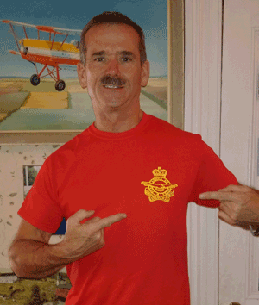
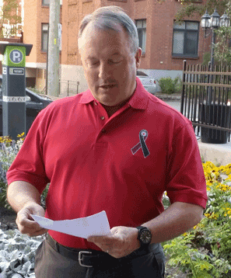
Support the Troops Red Friday Shirts
Mbr Non-Mbr
Tee shirt: $18 $25
Golf shirt: $30 $35
One of each: $40 n/a
Sizes: Medium, Large, X-Large, XX-Large
Golf shirt – unique Air Force ribbon & Roundel design
Profits to Air Cadet Continuation Flying Scholarship Fund
Primary RCAFA TF Fund Generation Goal
Toll free 1-800-351-2322 or email: kitshop@airforce.ca
RCAFA is indebted to Col(Ret) Chris Hadfield for his support to RCAC

Slide 22
Summary
Donations are vital
Please encourage Wings & Members to donate to the RCAF Association Trust Fund
Members can easily include a donation in their Will (by codicil) to “Non-Designated” Funds and we will have flexibility to shore up low funded areas as they arise.
If members wish not to donate, we will respect their choice and submit to dissolution of the RCAF Association Trust Fund

Slide 23
Summary
Funds enable support, assistance & promotion of:
Young Canadians, especially Air Cadets,
Canadian Aviation & Canadian Aviation History projects
and RCAF Association Wings*

Slide 24
Conclusion
Questions?
Thanks

